Slide 1


Welcome to Year 6
07.09.26
Miss Simner

Slide 2
Staff
Teacher
Miss Simner
Support Staff
Mr McFarlane (am only)
Mrs Southall and Miss C Esty (interventions)
Please talk to any of us if you have any questions or concerns when your child is in our class.

Slide 3

The Park Hill Family
High expectations
Hard work
Supportive
Build confidence
Celebrate the wins
Our values are at the centre of all we do – R.E.A.C.H.
Notes:
What will it be like to be a child in your class?
What will the ethos be like?
Supportive
A partnership
Engaging – we’ll have fun!
High expectations – achieve potential – will push but it’s because you want the best…
Tell parents how important good behaviour is within your classroom and how coinsistent and fair you will be.

Slide 4
Data Collection
It is really important that we have up-to-date details for each child.
Please read the forms sent out carefully and return them as soon as possible.
Parental responsibility, emergency contacts and medical / dietary needs are really important.
Please remember to return consent forms for trips and food tasting etc.

Slide 5
Attendance
Please contact the school office before the register is taken if your child is absent.
The register is taken at 8.55am and again at 1.00pm.
We will do all we can to support but the Local Authority will become involved if attendance is low.
We “reach” for 95% attendance.
Dawn Thompson is our Attendance Support Worker. She carries out home visits if no contact has been made.
Notes:
What will good attendance mean the children in your class receive?
Tell them Dawn is lovely but joke about not wanting her at the door!

Slide 6
Arrival and Collection
Please telephone or email the office if anyone else collects your child.
If you would like your child to walk home, please ensure we have permission as we will not let them go alone.
Phones will be locked in the office until the end of the day.
We apologise if dismissal takes a while as we get used to new faces!
A member of staff will be available on the gate or playground for you to ask any questions or share any concerns.

Slide 7
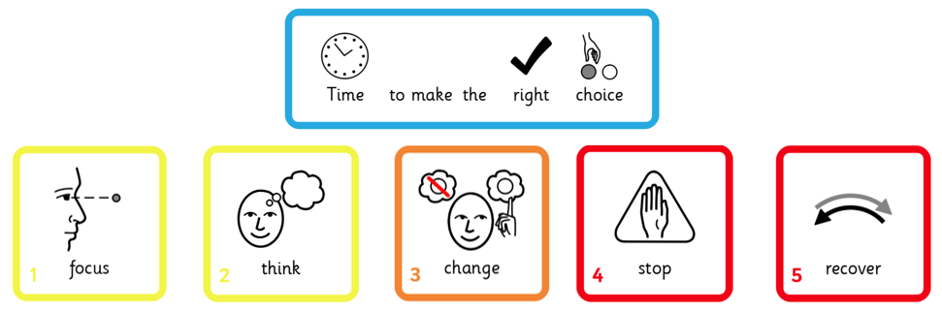
Behaviour
We really value your support in helping children identify the “right choice.”
Notes:
Quickly review the Behaviour Policy – emphasise reward and acknowledgement.

Slide 8
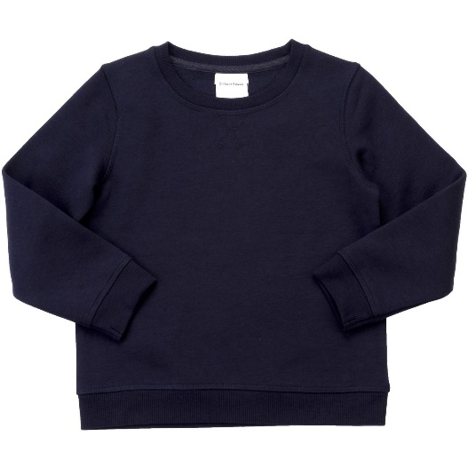
Belongings
Please label all belongings clearly.
We encourage children to be responsible for their own equipment.
Water or diluted squash.
The space on children’s pegs is very narrow. Larger rucksacks will not fit and can fall onto the floor, causing a fire hazard. Please only send necessary equipment.

Slide 9
Uniform
Grey or black trousers / skirt.
Black shoes.
White polo shirt.
Navy blue jumper.
Navy tracksuit and white trainers on PE days.
Outdoor clothing, including jackets and footwear for Forest School.
On Forest School days, children need spare clothes in case they get very muddy or wet. We don’t want anyone sitting in soggy clothes!
Notes:
Offer – children can leave spare clothes on their pegs.

Slide 10




Homework
Homework books – every Friday the children will receive a maths/reading and always a spelling sheet. This is to be handed in by Wednesday.
Daily reading – children can choose a school library book (please sign diaries).
TT Rockstars – really important for SATs
Maths Shed / Spelling shed – we are in the process of changing schemes (watch this space)
Please sign your child’s reading diary whenever and whatever they read!
Notes:
We know how valuable time at home is. Although teachers might set a one-off project now and then, we only expect the above as a minimum.

Slide 11
Reading
Reading comprehension
Inference
Retrieval
Word meaning
SATs papers are usually covered in these 3 areas.
Children make good progress when they read regularly as they have to understand unseen texts quickly in the SATs
Reading is critical to academic achievement across the curriculum – it is essential to success at the Year 6 level.
Notes:
Three key objectives for year group…

Slide 12
Writing
Narrative (dialogue, flashback and suspense)
Persuasion
Letter for complaint (formal writing)
Brochure for a theme park
Diary (after Drayton Manor)
Didactic poem
Autobiography
Children will be assessed over the year to determine their overall result in the Summer (moderation).
Notes:
Three key objectives for year group…

Slide 13
Maths
Fractions
Decimals
Percentages
Place value
Calculation (multiplication, division, addition and subtraction).
Times tables are vital for the Maths SATs papers and the children will be working at a fast pace – they will rely on their tables to calculate at speed.
Notes:
Three key objectives for year group…

Slide 14
Science
Electricity
Light
The circulatory system
Classifying living things
Evolution and inheritance
Looking after our environment
Science is also assessed over the year to determine your child’s result in the summer for high school
Notes:
Three key objectives for year group…

Slide 15
A final note…
Walking home
Homework and reading
SATs will start Monday 10th May 2027
High School open days:
WGA- Wednesday 23rd September
WOA- Wednesday 16th September
SATs parents talk in January
We look forward to watching your children mature this year as they transition to high school in the summer.
Notes:
What are you most excited about for the following year?
Final words to show families you care, are ambitious for their children and give them a sense of “who you are.”

