Slide 1


Welcome to Year 4
07.09.26
Miss Kaur

Slide 2
Staff
Teacher
Miss Kaur
Support Staff
Mrs Tandy
Mr McFarlane
Please talk to any of us if you have any questions or concerns when your child is in our class.

Slide 3

The Park Hill Family
Supportive Environment
Team work alongside with children
High Expectations – Behaviour
Star points, Reward box, Star of the day, Class Reward Jar
Accessible classroom resources
Engaging learning
Our values are at the centre of all we do – R.E.A.C.H.
Notes:
What will it be like to be a child in your class?
What will the ethos be like?
Supportive
A partnership
Engaging – we’ll have fun!
High expectations – achieve potential – will push but it’s because you want the best…
Tell parents how important good behaviour is within your classroom and how coinsistent and fair you will be.

Slide 4
Data Collection
It is really important that we have up-to-date details for each child.
Please read the forms sent out carefully and return them as soon as possible.
Parental responsibility, emergency contacts and medical / dietary needs are really important.
Please remember to return consent forms for trips and food tasting etc.

Slide 5
Attendance
Please contact the school office before the register is taken if your child is absent.
The register is taken at 8.55am and again at 1.00pm.
We will do all we can to support but the Local Authority will become involved if attendance is low.
We “reach” for 95% attendance.
Dawn Thompson is our Attendance Support Worker. She carries out home visits if no contact has been made.
Notes:
What will good attendance mean the children in your class receive?
Tell them Dawn is lovely but joke about not wanting her at the door!
Fines in place -

Slide 6
Arrival and Collection
Please telephone or email the office if anyone else collects your child.
Please supervise children on playgrounds before the bell goes, as staff are in briefings etc.
We apologise if dismissal takes a while as we get used to new faces!
A member of staff will be available on the gate or playground for you to ask any questions or share any concerns.

Slide 7
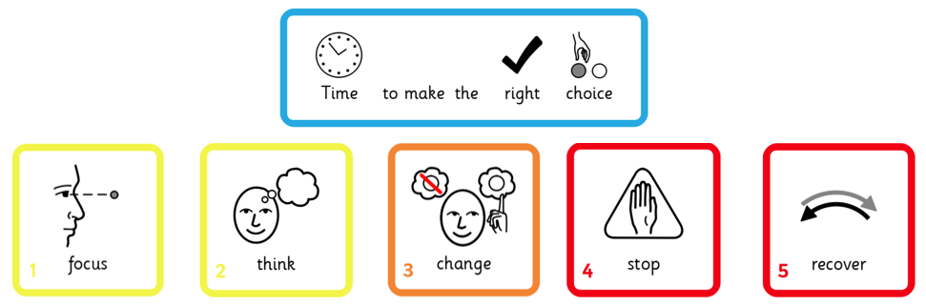
Behaviour
We really value your support in helping children identify the “right choice.”
Notes:
Quickly review the Behaviour Policy – emphasise reward and acknowledgement.

Slide 8

Belongings
Please label all belongings clearly.
We encourage children to be responsible for their own equipment.
Water or diluted squash.
The space on children’s pegs is very narrow. Larger rucksacks will not fit and can fall onto the floor, causing a fire hazard. Please only send necessary equipment.

Slide 9
Uniform
Grey or black trousers / skirt.
Black shoes.
White polo shirt.
Navy blue jumper.
Navy tracksuit and white trainers on PE days.
Outdoor clothing, including jackets and footwear for Forest School.
On Forest School days, children need spare clothes in case they get very muddy or wet. We don’t want anyone sitting in soggy clothes!
Notes:
Offer – children can leave spare clothes on their pegs.

Slide 10




Homework
Daily reading (children who do Read Write Inc can access books on Oxford Owl).
Times Tables Rockstars
Weekly homework, books sent home every Friday, returned by following Wednesday
Spelling shed / Maths shed (but watch this space as we will be launching a new spelling game!)
Please sign your child’s reading diary whenever and whatever they read!
Notes:
We know how valuable time at home is. Although teachers might set a one-off project now and then, we only expect the above as a minimum.

Slide 11
Reading
Text - The Firework Makers Daughter.
Improving reading fluency – daily reading time allowed for children to read for pleasure, supporting where needed.
Notes:
Three key objectives for year group…

Slide 12
Writing
Handwriting, letter formation and sizes.
Exploring range of sentence types, punctuation, e.g. fronted adverbials, Description text and persuasion text.
Coordinating conjunctions (FANBOYS – for, and, nor, but, or, yet, so)
Focus on handwriting and children implementing skills into the wider curriculum.
Notes:
Three key objectives for year group…

Slide 13
Maths
Place value - numbers up to 1000.
Addition and subtraction up to 4-digit numbers – using formal column method.
Measurement – area.
Multiplication tables check in June, very important year for children, as much practice at home with all time-tables up to 12.
Notes:
Three key objectives for year group…
We will support children – MTC help us identify if your child might need additional support.
On screen check – 25 times table questions, 6 seconds to answer each question – around 5 mins.

Slide 14
Science
Animals including humans
This term we will be learning about Organs in the digestive system and their functions, types of human teeth, effects of liquids on teeth, food chains and food webs.
Notes:
Three key objectives for year group…

Slide 15
The Wider Curriculum
Geography – Spatial Sense (Globes, Grid reference and our local area)
Art – Light
RE – Judaism
Science - Science – Animals including Humans
DT – Sewing week making cushions
PSHE - Health and wellbeing and thinking positively.
Watch this space for exciting news about our Art, History, Geography and DT curriculum.

Slide 16
A final note…
I am very excited to work with all the children helping meet their goals for the year and progress with confidence.
Please don’t hesitate to contact me during the year if you have any questions or concerns.
Notes:
What are you most excited about for the following year?
Final words to show families you care, are ambitious for their children and give them a sense of “who you are.”

