Slide 1


Welcome to Year 3
07.09.25
Miss M Cox

Slide 2
Staff
Teacher
Miss M Cox
Support Staff
Miss J Lawley
Please talk to any of us if you have any questions or concerns when your child is in our class.

Slide 3

The Park Hill Family
Supportive
Working in partnership
Caring
Fun
Treated fairly
High expectations
Our values are at the centre of all we do – R.E.A.C.H.
Notes:
What will it be like to be a child in your class?
What will the ethos be like?
Supportive
A partnership
Engaging – we’ll have fun!
High expectations – achieve potential – will push but it’s because you want the best…
Tell parents how important good behaviour is within your classroom and how consistent and fair you will be.

Slide 4
Data Collection
It is really important that we have up-to-date details for each child.
Please read the forms sent out carefully and return them as soon as possible.
Parental responsibility, emergency contacts and medical / dietary needs are really important.
Please remember to return consent forms for trips and food tasting etc.

Slide 5
Attendance
Please contact the school office before the register is taken if your child is absent.
The register is taken at 8.55am and again at 1.00pm.
We will do all we can to support but the Local Authority will become involved if attendance is low.
We “reach” for 95% attendance.
Dawn Thompson is our Attendance Support Worker. She carries out home visits if no contact has been made.
Notes:
What will good attendance mean the children in your class receive?
Tell them Dawn is lovely but joke about not wanting her at the door!
**190 school days = 100% 10 days = 95% 19 days = 90% 29 days = 85%

Slide 6
Arrival and Collection
Please telephone or email the office if anyone else will be collecting your child.
Please supervise children before the bell goes – staff will open gates as soon as they can. Children to make their way to class. Any worries or concerns can be given to staff on the gate to pass on, or through letters for children to hand to teachers.
I apologise if dismissal takes a while as I get used to new faces!
A member of staff will be available on the gate or playground for you to ask any questions or share any concerns.
Notes:
List some topics from PKC

Slide 7
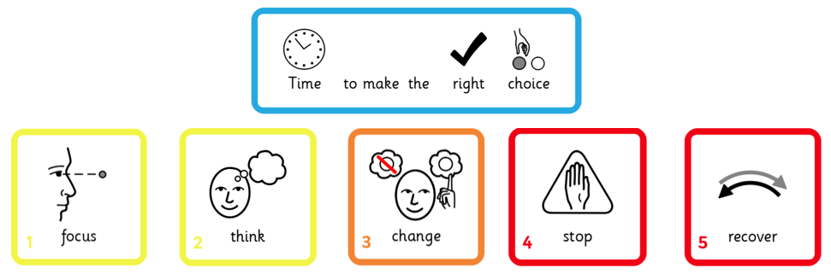
Behaviour
We really value your support in helping children identify the “right choice.”
Notes:
Quickly review the Behaviour Policy – emphasise reward and acknowledgement.

Slide 8

Belongings
Please label all belongings clearly.
We encourage children to be responsible for their own equipment.
Water or diluted squash.
The space on children’s pegs is very narrow. Larger rucksacks will not fit and can fall onto the floor, causing a fire hazard. Please only send necessary equipment.

Slide 9
Uniform
Grey or black trousers / skirt.
Black shoes.
White polo shirt.
Navy blue jumper.
Navy tracksuit and white trainers on PE days. (Tuesday - morning)
Outdoor clothing, including jackets and footwear for Forest School. (Thursday - afternoon)
On Forest School days, children need spare clothes in case they get very muddy or wet. We don’t want anyone sitting in soggy clothes!
Notes:
Offer – children can leave spare clothes on their pegs.

Slide 10




Homework
Homework books – every Friday with Arithmetic or Spelling work from that week – hand in by Wednesday.
Daily reading – school library books. Children who do Read Write Inc. have a RWI story book too and can also access books on Oxford Owl).
Times Tables Rockstars
Spelling Shed / Maths Shed (but watch this space as we will be launching a new spelling game!)
Please sign your child’s reading diary whenever and whatever they read!
Notes:
We know how valuable time at home is. Although teachers might set a one-off project now and then, we only expect the above as a minimum.

Slide 11
Reading
Read more independently, check the text makes sense, discuss understanding, and the meaning of words in context
Draw inferences such as inferring characters’ feelings, thoughts and motives from their actions, and justify inferences with evidence
Summarise main events in a text.
Reading for pleasure is important.
Notes:
Reading for pleasure – RWI for those who still need it – Reading dogs – EVERY day!!

Slide 12
Writing
Correct punctuation, including commas, apostrophes and direct speech
Construction of sentences and cohesion between paragraphs.
Improved choice of adjectives, adverbs and verbs.
Children need to take pride in their writing and their presentation of their work.
Notes:
Different types of writing – find errors in their own work – NEVER just take first thought
**HANDWRITING AND SPELLING LESSONS EACH WEEK

Slide 13
Maths
Recognise the place value of each digit in a 3-digit number (100s, 10s, 1s)
Add and subtract numbers with up to 3 digits
Recall and use multiplication and division facts for the 3, 4 and 8 multiplication tables
EVERYONE can do maths – it all starts with giving your best shot!
Notes:
**TT Rockstars – MathShed – Arithmetic tests

Slide 14
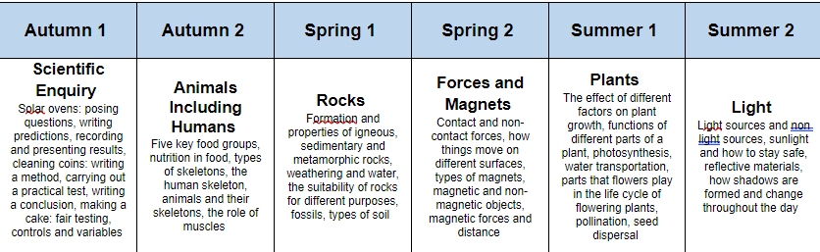
Science
Making predictions
Fair testing and recording results
Making scientific conclusions based on your evidence
…..
Notes:
Three key objectives for year group…

Slide 15
The Wider Curriculum
History – Stone Age to Iron Age, Ancient Egypt, Ancient Greece
Geography – Maps/ compasses, Settlements, Rivers
Art – Use of line, Still life, Art of Ancient Egypt, Anglo-Saxon art, Architecture
DT – sewing (keyrings), building (pop-up books), cooking (bread and butter, pasta bake)
New for your children this year will be weekly Spanish lessons.
Notes:
List some topics from PKC

Slide 16
A final note…
Welcome to KS2
Thank you for coming this evening
Notice will be given for any trips in advance
Let’s make this the best year ever!
2026 - 2027
Notes:
What are you most excited about for the following year?
Final words to show families you care, are ambitious for their children and give them a sense of “who you are.”

