Slide 1


Welcome to Year 1
07.09.26
Miss Milman

Slide 2
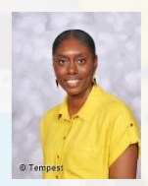
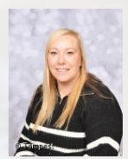
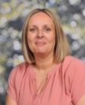
Staff
Teachers ~
Miss Milman (Mon-Thur) Mrs Southall/Miss Esty (Fri)
Support Staff ~
Mrs Perry
Please talk to any of us if you have any questions or concerns when your child is in our class.

Slide 3

The Park Hill Family in Year 1
Friendly, happy, calm ethos – always!​
Positive attitudes – it’s a big year (but a fun one!)
​
High expectations – achieving our potential.
Supporting one another (children and families).
Our values are at the centre of all we do – R.E.A.C.H.
Notes:
What will it be like to be a child in your class?
What will the ethos be like?
Supportive
A partnership
Engaging – we’ll have fun!
High expectations – achieve potential – will push but it’s because you want the best…
Tell parents how important good behaviour is within your classroom and how coinsistent and fair you will be.

Slide 4
Data Collection
It is really important that we have up-to-date details for each child.
Please read the forms sent out carefully and return them as soon as possible.
Parental responsibility, emergency contacts and medical / dietary needs are really important.
Please remember to return consent forms for trips and food tasting etc.

Slide 5
Attendance
Please contact the school office before the register is taken if your child is absent.
The register is taken at 8.55am and again at 1.00pm.
We will do all we can to support but the Local Authority will become involved if attendance is low.
We “reach” for 95% attendance.
Dawn Thompson is our Attendance Support Worker.
She carries out home visits if no contact has been made.
Notes:
What will good attendance mean the children in your class receive?
Tell them Dawn is lovely but joke about not wanting her at the door!

Slide 6
Arrival and Collection
Please telephone or email the office if anyone else collects your child.
We apologise if dismissal takes a while as we get used to new faces!
A member of staff will be available on the gate or playground for you to ask any questions or share any concerns.
Notes:
List some topics from PKC

Slide 7
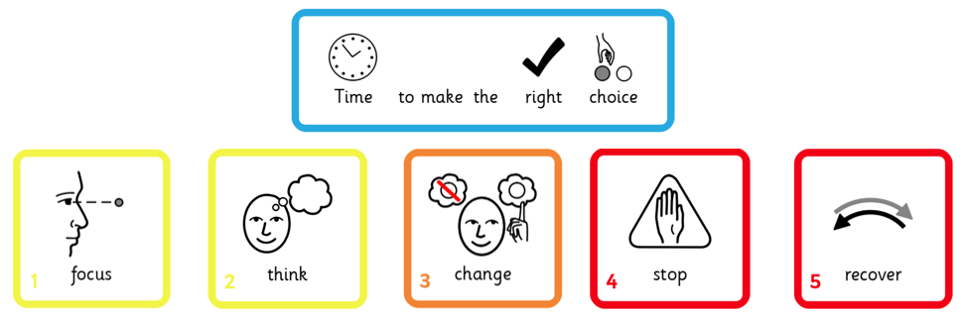
Behaviour
We really value your support in helping children identify the “right choice.”
Notes:
Quickly review the Behaviour Policy – emphasise reward and acknowledgement.

Slide 8
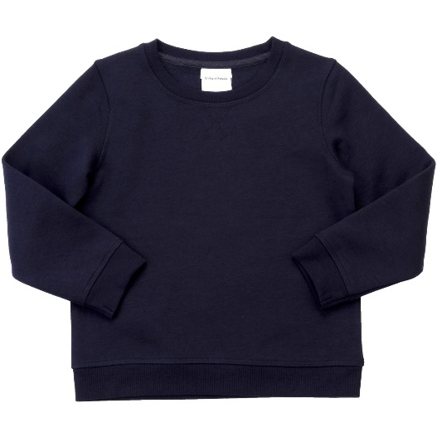
Belongings
Please label all belongings clearly.
We encourage children to be responsible for their own equipment.
Water or diluted squash.
The space on children’s pegs is very narrow. Larger rucksacks will not fit and can fall onto the floor, causing a trip and fire hazard.
Please only send necessary equipment.

Slide 9
Uniform
Grey or black trousers / skirt.
Black shoes.
White polo shirt.
Navy blue jumper.
Navy tracksuit and white trainers on PE days. (Monday)
Outdoor clothing, including jackets and footwear for Forest School. (Wednesday)
On Forest School days, children need spare clothes in case they get very muddy or wet.
We don’t want anyone sitting in soggy clothes!
Notes:
Offer – children can leave spare clothes on their pegs.

Slide 10




Homework
Daily reading (children who do RWI can access books on Oxford Owl).
Homework book with one spelling and one maths task sheet in.
Sent home on a Friday and returned by the following Wednesday please.
Please sign your child’s reading diary whenever and whatever they read!
Notes:
We know how valuable time at home is. Although teachers might set a one-off project now and then, we only expect the above as a minimum.

Slide 11
Phonics Screening Check
Year 1 – Every June
Assessment of their phonics skills
Real words and nonsense words
40 words (currently a pass is 31 – was 32 for many years)
Retested in Year 2 if not scored 31
Carried out with a familiar teacher
Able to use ‘Fred talk’ to read the words
Children will continue to receive daily phonics input during RWI sessions.
Notes:
Three key objectives for year group…

Slide 12
Reading
Recite some familiar rhymes and songs by heart
Recognise and join in with predictable phrases
Sound and blend unfamiliar words accurately using their phonic knowledge
Read aloud, checking that it ‘sounds right’ and that the text makes sense to them.
Three Little Pigs, Gingerbread Man, Lost and Found, Jim and the Beanstalk, Where the Wild Things Are, The Ugly Five, Dogger
Notes:
Three key objectives for year group…

Slide 13
Writing
Autumn 1 – Rhyme and character descriptions
Autumn 2 – Instructions and setting descriptions
Spring 1 – Character description and short burst poetry
Spring 2 – Lists and information fact files
Summer 1 – Recounts and losing tales
Summer 2 – Diary recounts and setting descriptions
Each half term we will look at both fiction and non-fiction writing. We will link writing outcomes to our class texts.
Notes:
Three key objectives for year group…

Slide 14
Maths
Place value
Addition & subtraction
Length and height
Mass and volume
Multiplication and division
Fractions
Money
Time
Lots of practical activities and resources available to help with maths learning.
Notes:
Three key objectives for year group…

Slide 15
Science
Seasonal Changes – The Seasons
Animals, Including Humans 1 – All about me
Exploring Everyday Materials 1 - Identifying and naming materials
Exploring Everyday Materials 2 - Building waterproof structures
Plants - Parts of a plant, environments for growth
Animals, Including Humans 2 – All about animals
Acquiring scientific knowledge and investigation through carrying out experiments.
Notes:
Three key objectives for year group…

Slide 16
The Wider Curriculum
History ~ Discovering History, Kings, Queens & Leaders, Parliament and Prime Ministers
Geography ~ Spatial Sense (maps), The UK, Seven Continents
Art ~ Colour, Line, Architecture, Narrative Art, Paintings of Children, Sculpture
DT ~ Cook - Dips and Vegetables, Jam Tarts / Mince Pies
Sew - Animal Sock Puppet Build - Vehicles
Notes:
List some topics from PKC

Slide 17


A final note…
We are all looking forward to a great year of learning!
Some fantastic new topics to explore together.
We really do want the best (and will work our hardest) for your children.​
We can’t wait to spend the year with your children, watching them learn and grow.
Notes:
What are you most excited about for the following year?
Final words to show families you care, are ambitious for their children and give them a sense of “who you are.”

