Slide 1


Year 6 SATs Information
23.01.25

Slide 2
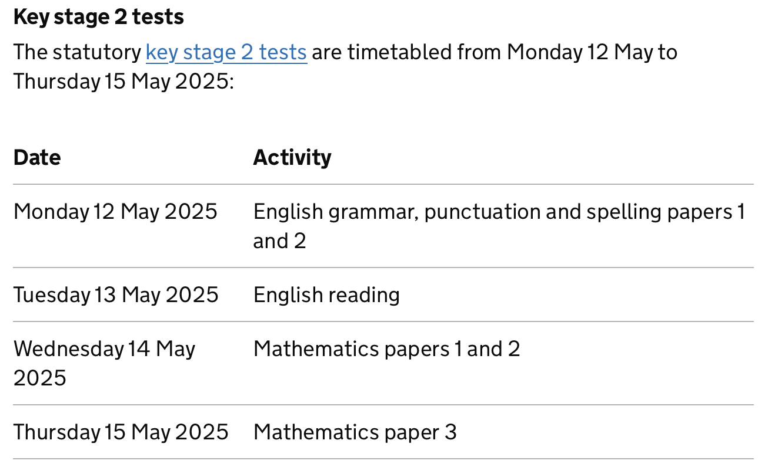
When are the tests?

Slide 3
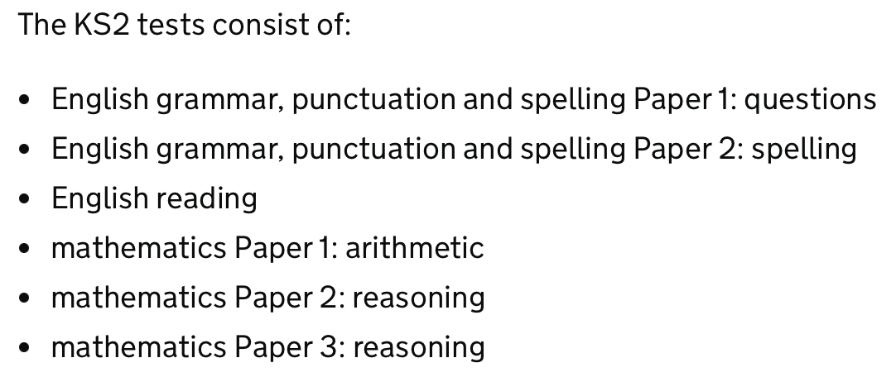
What subjects do children take tests in?

Slide 4
What about Writing and Science?
Writing and Science are teacher assessed.
Teachers make judgements against the Teacher Assessment Framework
The Local Authority then moderates the judgements for Writing.

Slide 5
What outcomes can there be?
Children are assessed as one of the following for Writing:
PKS – pre-key stage
WTS – working towards
EXS – expected standard
GDS – greater depth
EM – assessed using the engagement model (for children working below and not engaged in subject-specific study)
Children are assessed as one of the following for Science:
EXS – expected standard
HNM – has not met the standard

Slide 6
What about scores for the SATs tests?
A scaled score of 100 represents the ‘national standard’.
Each pupil’s raw test score will be converted into a ‘scaled score,’ either at, above or below 100.
Using the scaled score, the lowest a child can score is 80, with the highest being 120.
A child who achieves the ‘national standard’ (a score of 100) will be judged to be working at the expected standard.

Slide 7
Scaled score examples
On publication of the test results in July:
A child awarded a scaled score of 100 is judged to have met the national standard.
If a child’s score is above 110, they are working beyond above the national standard.
A child’s score is below 100, they are judged to have not yet met the national standard.

Slide 8
Roughly how many marks is that?
Conversion tables change every year, so an exact threshold is not available.
However, past results have always been around the following:
Grammar, Punctuation and Spelling | Reading | Maths
36 out of 70 | 28 out of 50 | 56 out of 110

Slide 9

When do I find out about my child’s results?
Schools can view the test results online on Tuesday 8th July.
We share results with the children as soon as we have them.
We also send the results home with your child’s end-of-year reports.

Slide 10
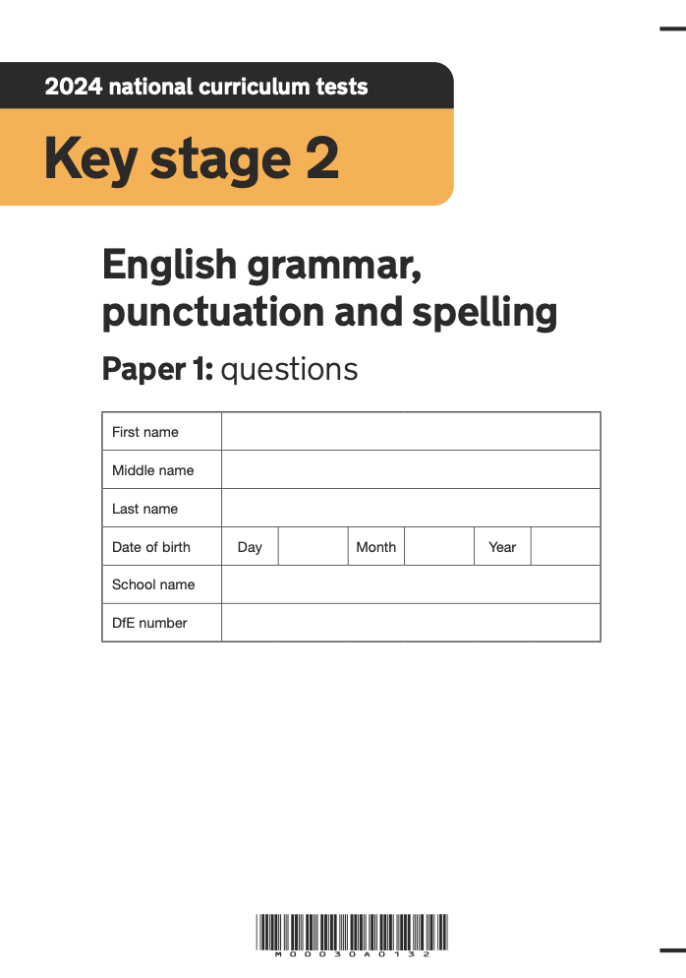
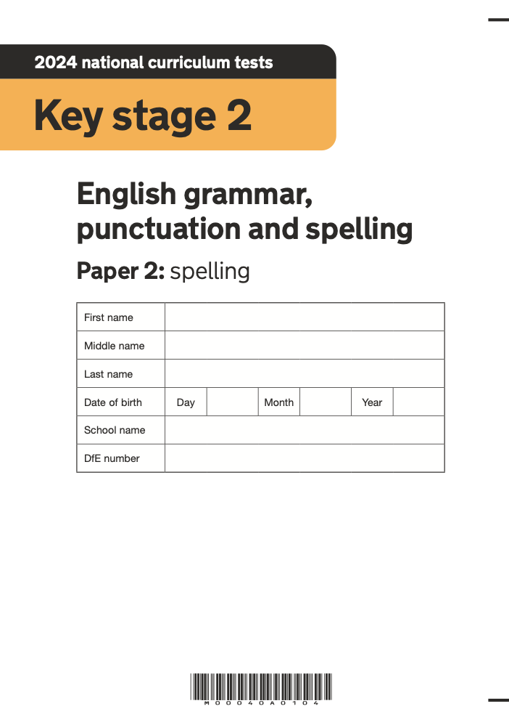
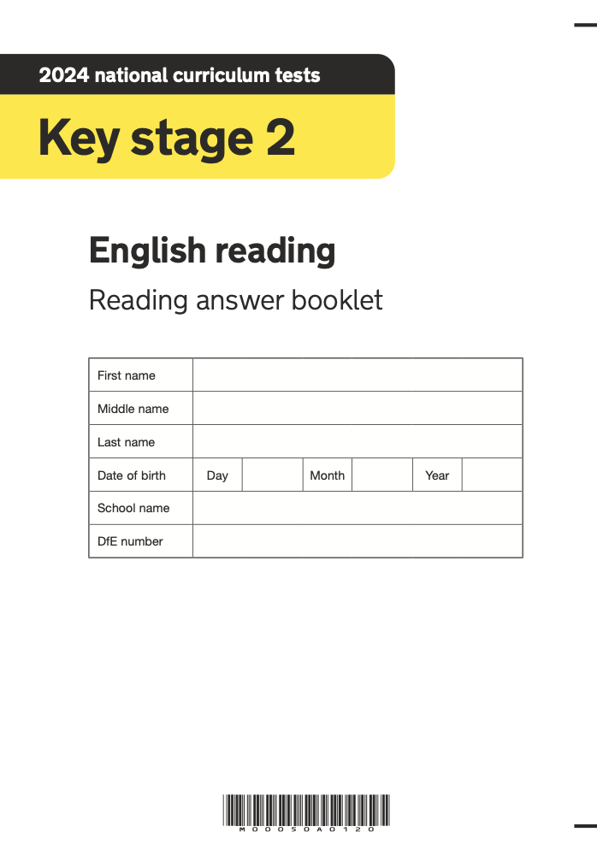
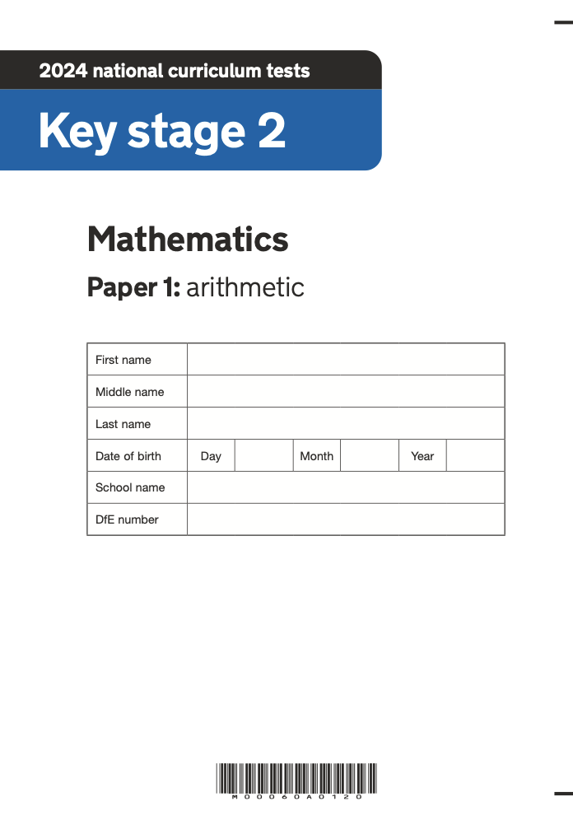
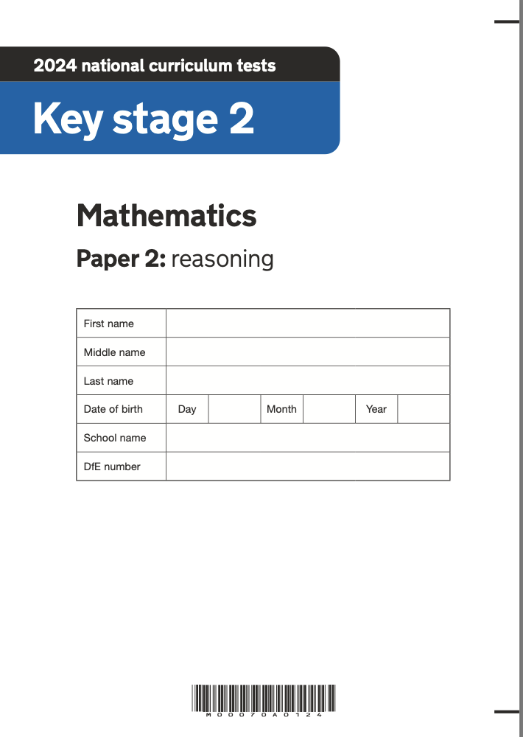
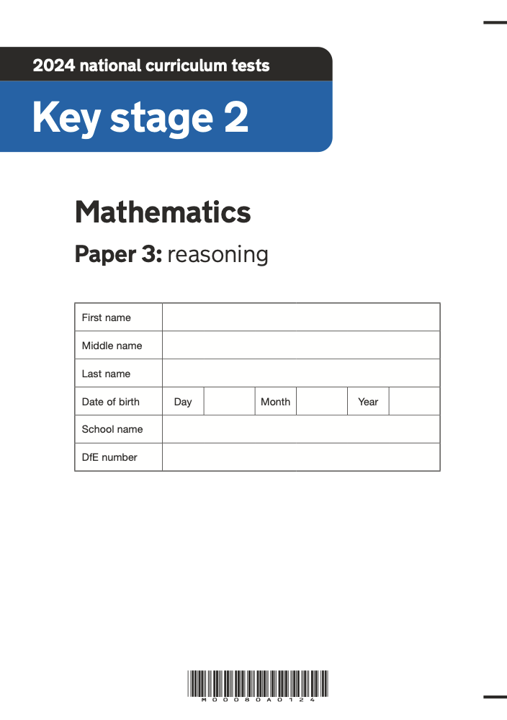
What do the tests look like?

Slide 11
Reading
The reading test consists of a single test paper with three unrelated reading texts. Children are given 60 minutes in total, which includes reading the texts and answering the questions.
A total of 50 marks are available.
Questions are designed to assess the comprehension and understanding of a child’s reading.
During the reading paper, a child’s inference and deduction skills are thoroughly tested. They will also be expected to answer questions on authorial choices: explaining why an author has chosen to use particular vocabulary, grammar and text features.
Some questions are multiple choice or selected response; others require short answers and some require an extended response or explanation.

Slide 12
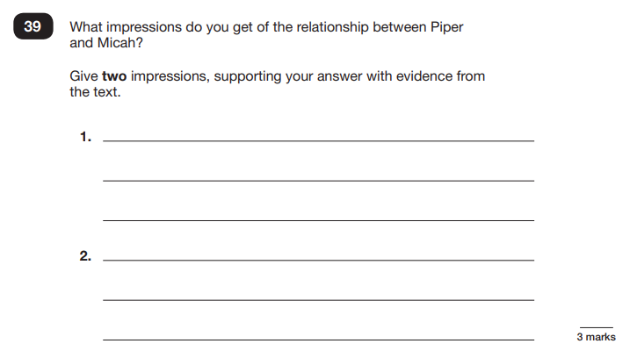
Sample Questions
Reading Paper

Slide 13
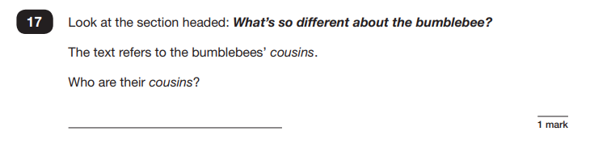
Sample Questions
Reading Paper

Slide 14
Grammar, Punctuation & Spelling
A spelling test is administered containing 20 words, which lasts approximately 15 minutes.
A separate test is given on grammar, punctuation and vocabulary.
This test lasts for 45 minutes and requires short answer questions including some multiple choice.
Marks for these two tests are added together to give a total for grammar, punctuation and spelling.

Slide 15
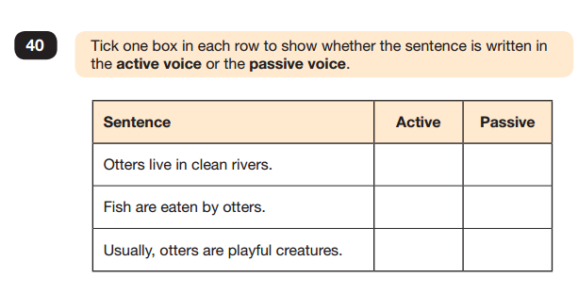
Sample Questions
Grammar, Punctuation and Spelling Paper 1

Slide 16
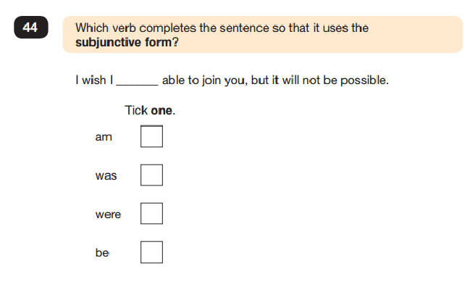
Sample Questions
Grammar, Punctuation and Spelling Paper 1

Slide 17
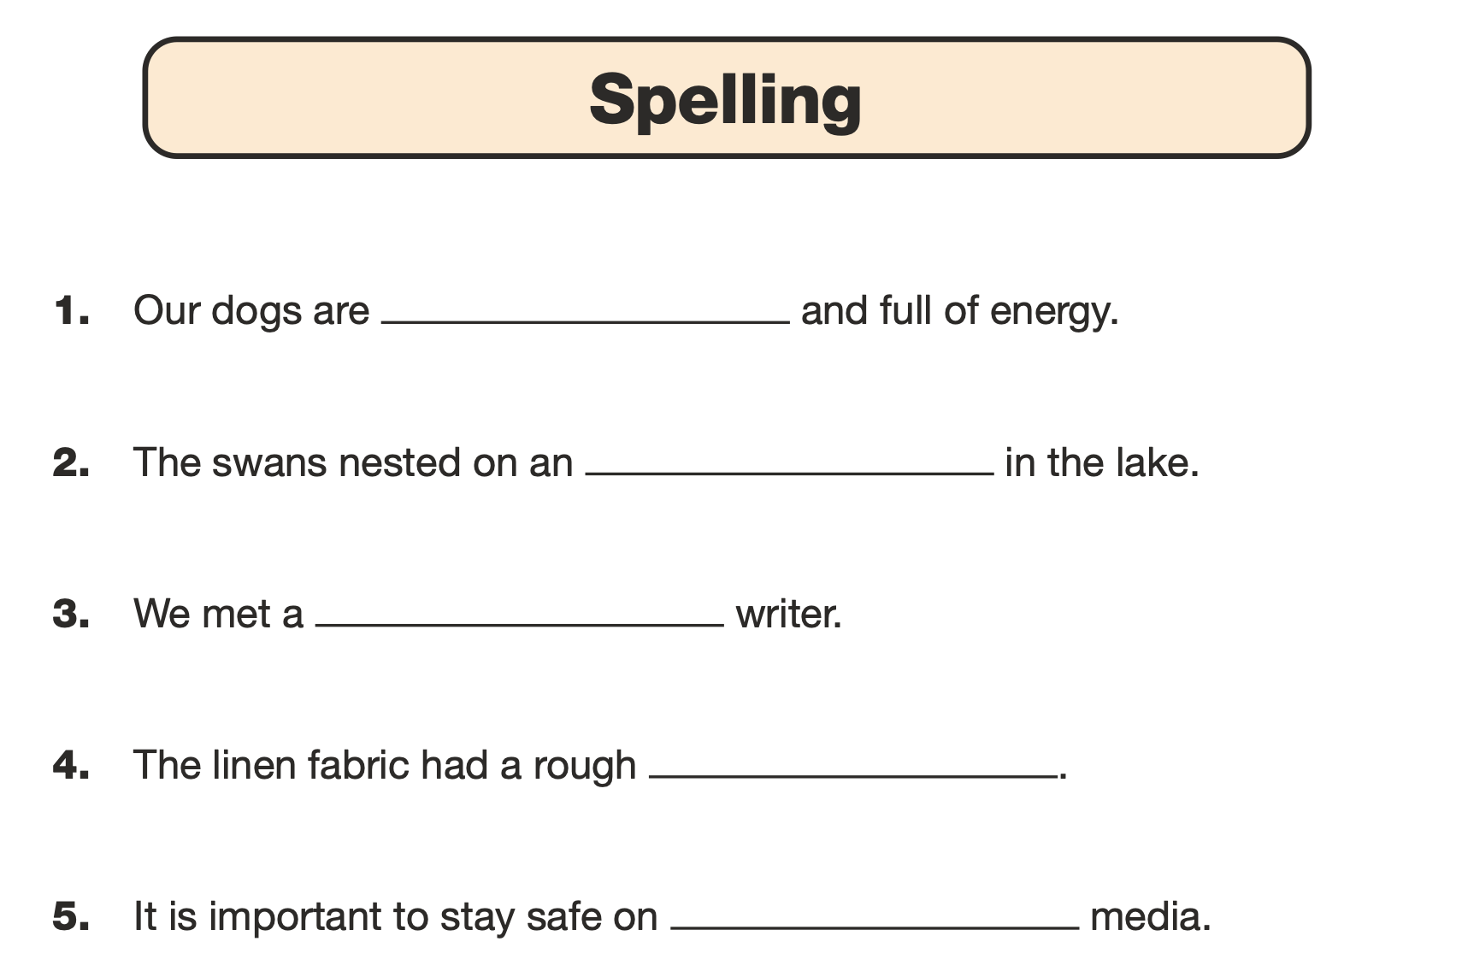
Sample Questions
Grammar, Punctuation and Spelling Paper 2
Notes:
1 – young
2 – island
3 – famous
4 – texture
5 - social

Slide 18
Mathematics
Children will sit three tests: paper 1, paper 2 and paper 3.
Paper 1 is for arithmetic, lasting for 30 minutes, covering calculation methods for all operations, including use of fractions, percentages and decimals.
Questions gradually increase in difficulty. Not all children will be expected to access some of the more difficult questions later in the paper.
Papers 2 and 3 cover problem solving and reasoning, each lasting for 40 minutes.
Pupils will still require calculation skills but will need to answer questions in context and decide what is required to find a solution.

Slide 19
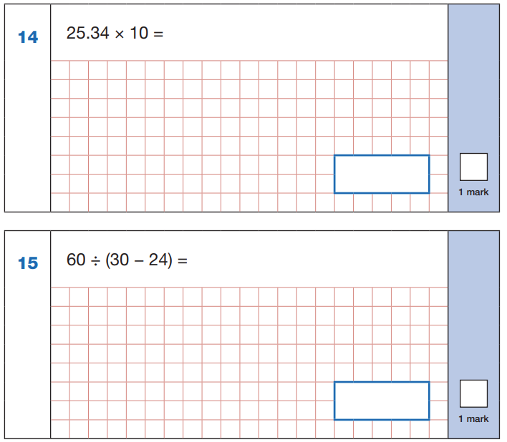
Sample Questions
Maths Paper 1: Arithmetic

Slide 20
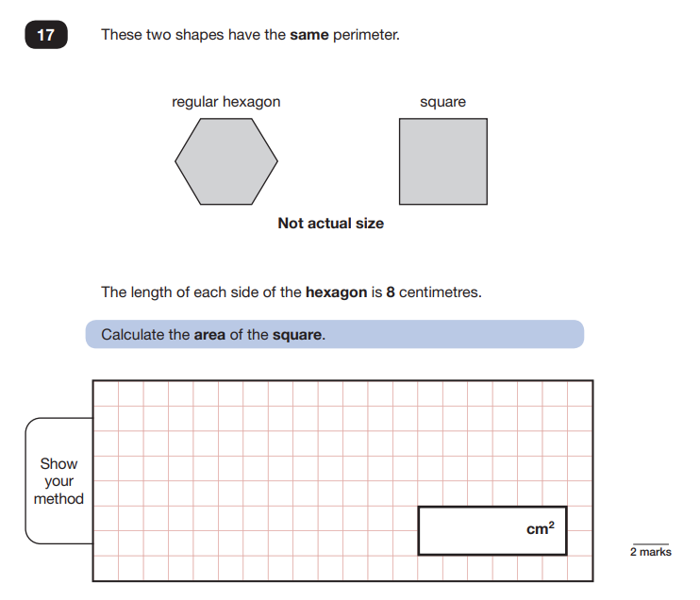
Sample Questions
Maths Paper 2 / Paper 3 : Reasoning

Slide 21
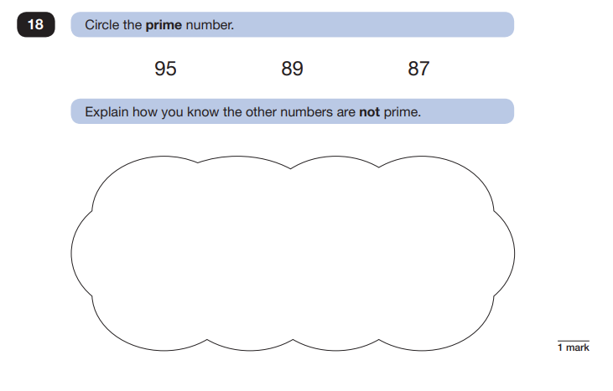
Sample Questions
Maths Paper 2 / Paper 3 : Reasoning

Slide 22
What does school do to help prepare my child?
SATs club with Miss Simner – Wednesdays after school.
CGP revision guides – we can order these at a discounted rate.
Extra practice material sent home as homework.
Free Breakfast Club during the week of SATs.
Regular low-stakes practice – we use example questions in lessons so that children are familiar with them.
Mrs Logan and Mrs Boardman provide extra support.

Slide 23
How can I support my child?
Support and reassure your child that there is nothing to worry about and they should always just try their best. Praise and encourage!
Ensure your child has the best possible attendance at school.
Support your child with any homework tasks.
Reading (and talking about what children read), spelling and arithmetic (e.g. times tables).
Make sure your child has a good sleep and healthy breakfast every morning!

Slide 24
Key Ideas for Reading
Make sure they continue to read at home and ask them to read aloud to you.
Vocabulary – look up definitions of unknown words together.
Fluency – the speed of the test means that children need to be able to skim and scan a text.

Slide 25
Key Ideas for Maths
Practise times tables – the time limits of the tests mean that children who know their times tables can use these facts to answer so many different questions quickly.
Support your child with arithmetic (addition, subtraction, multiplication, division, fractions, decimals and percentages).
Talk about how they found the answers to any problems.

Slide 26
Key Ideas for Writing
Practise spelling (Year 3 and Year 4 spelling rules and words come up a lot in the GPS test).
Encourage neat presentation.
Ensure that children use basic punctuation when writing (even when typing!)

Slide 27



Online Resources
Free 10 Minute Tests for Maths and Grammar, Punctuation and Spelling – answers are given:
https://www.cgpbooks.co.uk/resources/ks2-sats-online-10-minute-tests
Free BBC Bitesize – choose Key Stage 2 SATs on the tabs on the left:
https://www.bbc.co.uk/bitesize/articles/zrybvk7#zs82p9q
Login to Spelling Shed and Maths Shed with your school login:
https://www.edshed.com/en-gb/login

Slide 28

Thank you...

