Slide 1


Phonics Screening Check Information
23.01.25

Slide 2
What is the Phonics Screening Check?
A decoding (word reading) test at the end of Year 1.
It does not assess reading comprehension or spoken language.
Designed to check that children know the expected sounds and can decode unfamiliar words.
40 words
20 are real words
20 are pseudo (nonsense) words
Expected mark has been 32 for a number of years

Slide 3

When is the Phonics Screening Check?
Week commencing 9th June 2025.
Please ensure good attendance.
Not present to take the check during the testing window equals no mark.

Slide 4
How is the check carried out?
One-to-one with Mrs Boardman, over the course of the week
Relaxed and comfortable
Usually takes between 2 and 5 minutes but we go at the child’s pace.
Children read a word at a time and their responses are noted down.
Any speech and language needs or accents are taken into account and not recorded as incorrect e.g. if a child usually pronounces “r” as “w” and reads “frown” as “fwown.”

Slide 5
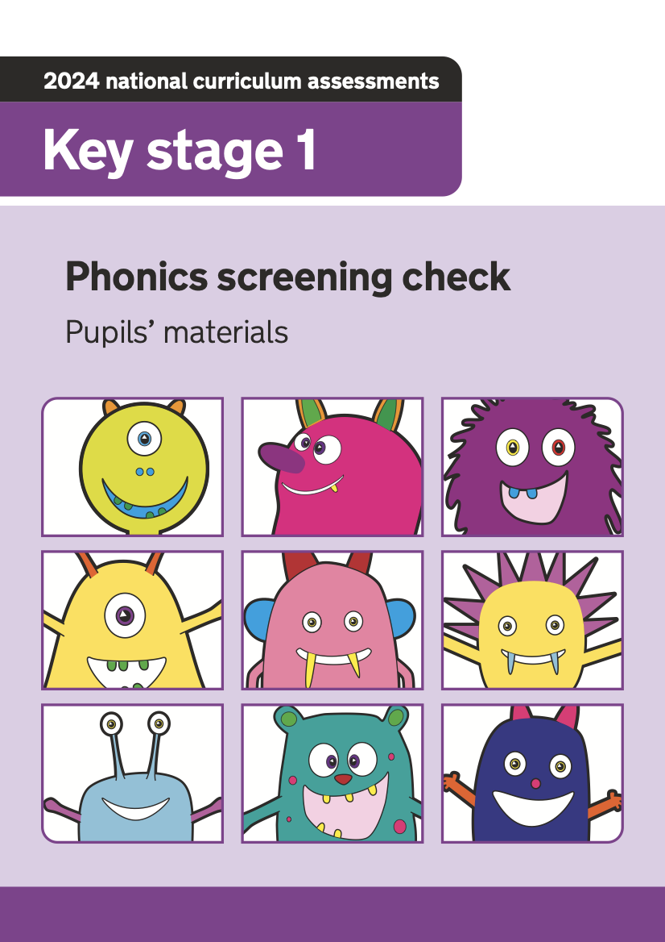
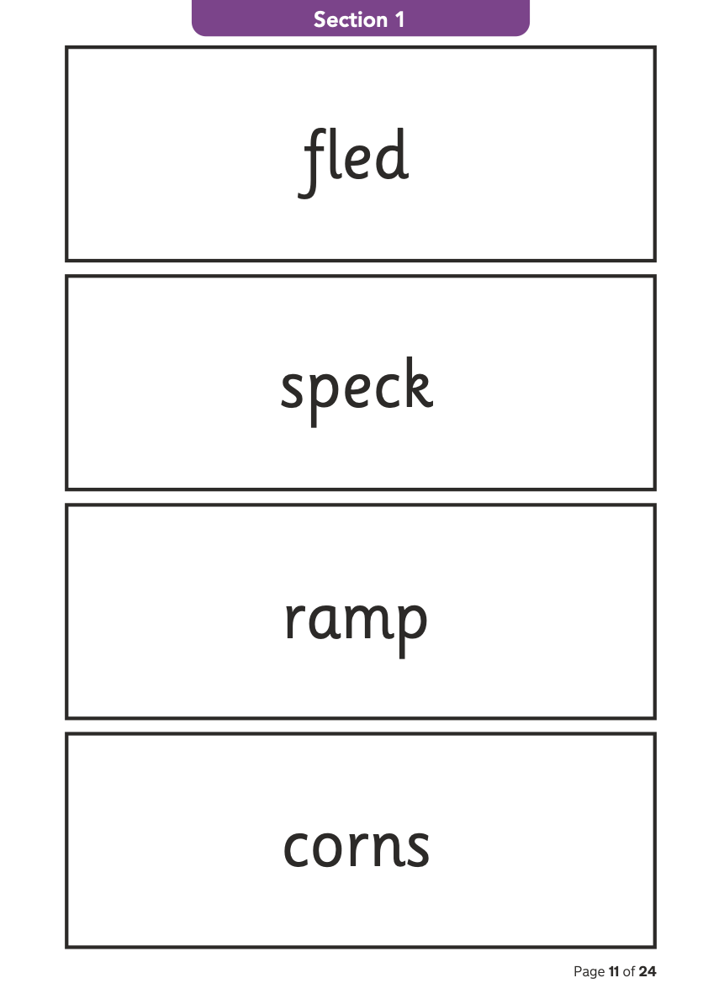
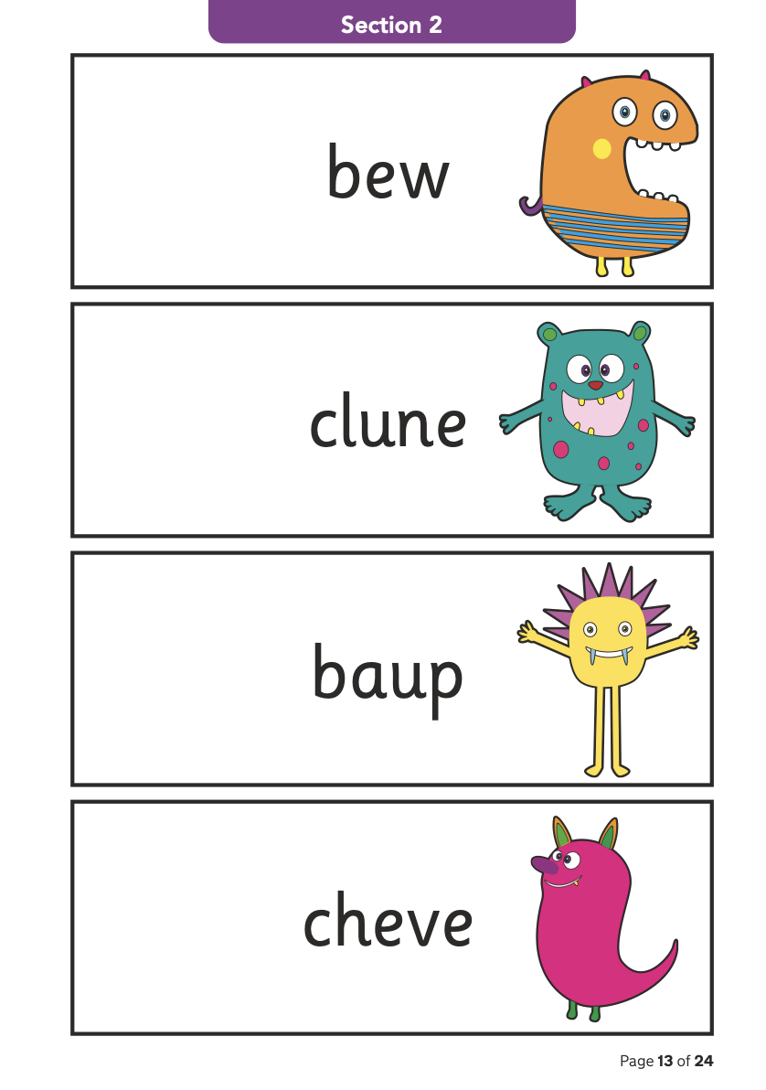
What does it look like?

Slide 6
What sounds do the words contain?
Section 1 – sounds that children learned first (in Reception)
In Read Write Inc, these are mainly “Set 1” sounds
Section 2 – alternative spellings of sounds that children learn in Year 1
In Read Write Inc, these are mainly ”Set 2 and Set 3” sounds

Slide 7
All Speed Sounds
Notes:
Children learn all of the sounds on this chart.
Once they know all of these sounds, they will be able to read any unfamiliar word.

Slide 8
How do we support children before the check?
Each element of a Read Write Inc session teaches children the sounds they need.
Children practice searching for “special friends” (two letters that make one sound), before ”Fred talking” (blending aloud) and reading the word.
Children who have sound gaps are tutored for 5 minutes per afternoon.
We also do shorter afternoon practice sessions.

Slide 9

‘Special Friends’, ‘Fred Talk’
Notes:
We teach children to words using the routine ‘Special Friends’, ‘Fred Talk’, read the word’.
Children spot the ‘Special Friends’ (two letters that make one sound), Fred talk the word, and then read the whole word.
For example, ‘sh’, sh-i-p, ship.

Slide 10



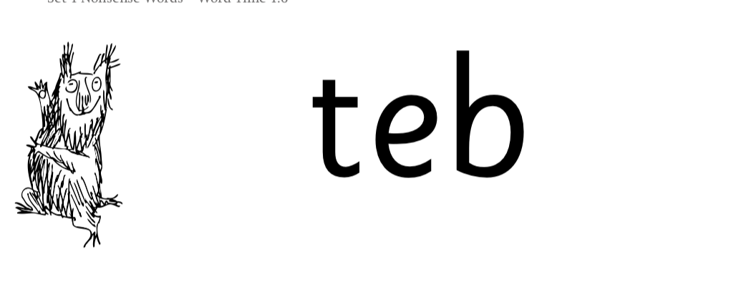
Nonsense words
Notes:
Half of the words in the check are real words.
Half are nonsense words. For example, ‘sheb’, ‘glight’, ‘ched’, ‘teb’.
There is a picture of an alien next to each word to remind the children that it isn’t a real word.
Nonsense words are used to assess children’s reading.
They check that children will be able to read sounds the sounds they know in unfamiliar words.
They read these words using the same routine as real words – ‘Special Friends, Fred Talk.’
Children who can read nonsense words will, very soon, be able to read any new word – for example – gargantuan, flailing, raucous, anticipation;
Reading new words increases children’s vocabulary rapidly.

Slide 11
What can be done at home?
Hear your child read their bookbag book every day.
If children pause over an unfamiliar word, prompt: ”Special friends? Fred talk. Read the word.”
Practice reading sounds speedily (Set 2 and Set 3 packs will be sent home).
If children are unsure of a sound, show the picture side of the card and say the phrase.
Virtual classroom films from Read Write Inc are sent on SeeSaw.
Oxford Owl books are also set online for each child.

Slide 12
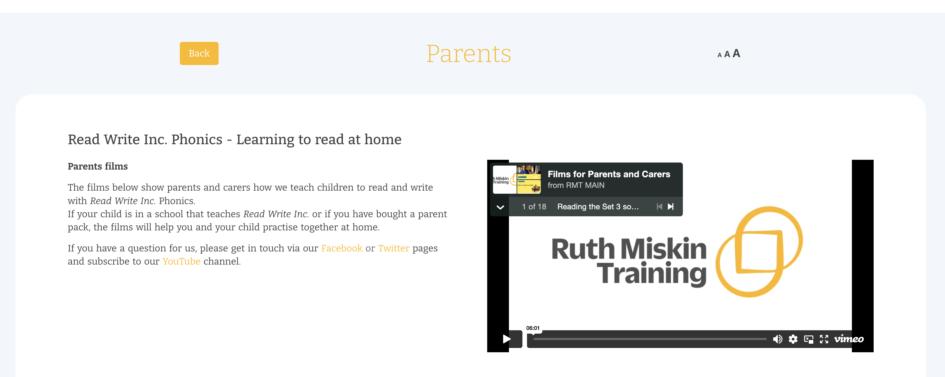
Free Video Tutorials (ruthmiskin.com)
Notes:
Watch these video tutorials on the Ruth Miskin website to find out more about the PSC:
Understanding Phonics
The Phonics Screening Check

Slide 13
Online resources available
Ruth Miskin Parents’ Page:
https://www.ruthmiskin.com/parents/
Ruth Miskin Facebook:
https://www.facebook.com/miskin.education
Previous checks:
https://www.gov.uk/government/collections/national-curriculum-assessments-past-test-materials#phonics-screening-check-resources

Slide 14
When will families find out their child’s score?
We send home their score with their end-of-year report.
This is because of DfE releasing the expected mark, DfE data collection dates and monitoring visits.

Slide 15
What if my child does not meet the required mark?
Children are given extra support throughout Year 2 e.g. continued Read Write Inc sessions and tutoring.
They then re-take the check in the June of Year 2.
This is so that we can make sure they recognise the sounds and can decode unfamiliar words before they go into Key Stage 2.

Slide 16

Thank you...

