Slide 1


Multiplication Tables Check Information
20.01.25

Slide 2
Who will take the Multiplication Tables Check?
All eligible year 4 children who are registered at schools in England will be required to take the check.
The purpose of the check is to determine whether your child can fluently recall their times tables up to 12. It will also help us identify who may need additional support

Slide 3
What is the multiplication Tables Check?
It is an on-screen check consisting of 25 times table questions.
Your child will be able to answer 3 practice questions before taking the actual check.
They will then have 6 seconds to answer each question.
On average, the check should take no longer than 5 minutes to complete.

Slide 4

When is the Multiplication Tables Check?
Between Monday 2 June and Friday 13 June.
16 June to Friday 20 June – check for pupils who were absent during the first 2 weeks or any problems due to technical difficulties.
A ‘try-it-out’ period is given to practice from the end of April

Slide 5
How is the check carried out?
The Times Tables Check is online and on-screen (iPads)
The test will be fully digital and take place on screen. It is available to use on laptops and iPads.
3 Practice questions will be asked before it starts. 25 questions will be asked
Children will have 6 seconds to answer each question
Access arrangements may be appropriate for pupils with specific needs who require additional arrangements so they can take part in the MTC (e.g. pause between questions)
There is no expected pass rate or threshold. This means that, unlike the KS1 Phonics Screening check, children will not be expected to re-sit the check if they do not meet a set threshold in this KS2 Times Tables Test.
If, however, there is disruption that day, or technical issues happen – it can organised for them to retake.

Slide 6
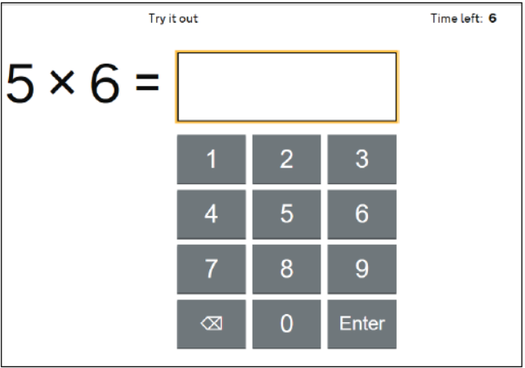
What does it look like?
Time left (counts down from 6)
Question
Keypad

Slide 7
How can we support children before the check?
https://www.timestables.co.uk/multiplication-tables-check/
https://mathsframe.co.uk/en/resources/resource/477/Multiplication-Tables-Check
TT Rockstars soundcheck
These resources are being created along with others for free online – they allow you to try out the same settings as the MTC at home and get used to the format.

Slide 8
What can be done at home?
Make it real – how many legs has 6 spiders? Etc…
YouTube videos showing tricks to learning x tables
Play x tables games
Wall charts (free on Oxford Owl)
https://cdn.oxfordowl.co.uk/2018/11/16/16/46/58/693/TimesTables_1_12.pdf
Practise – whether verbally or online

Slide 9
When will families find out their child’s score?
Once the dates for the check are complete (20.06.25) we should be able to access scores and can share with the children the following Monday (23.06.25)
We can also give scores in end of year reports as confirmation.

Slide 10

Thank you...

